Slide 1

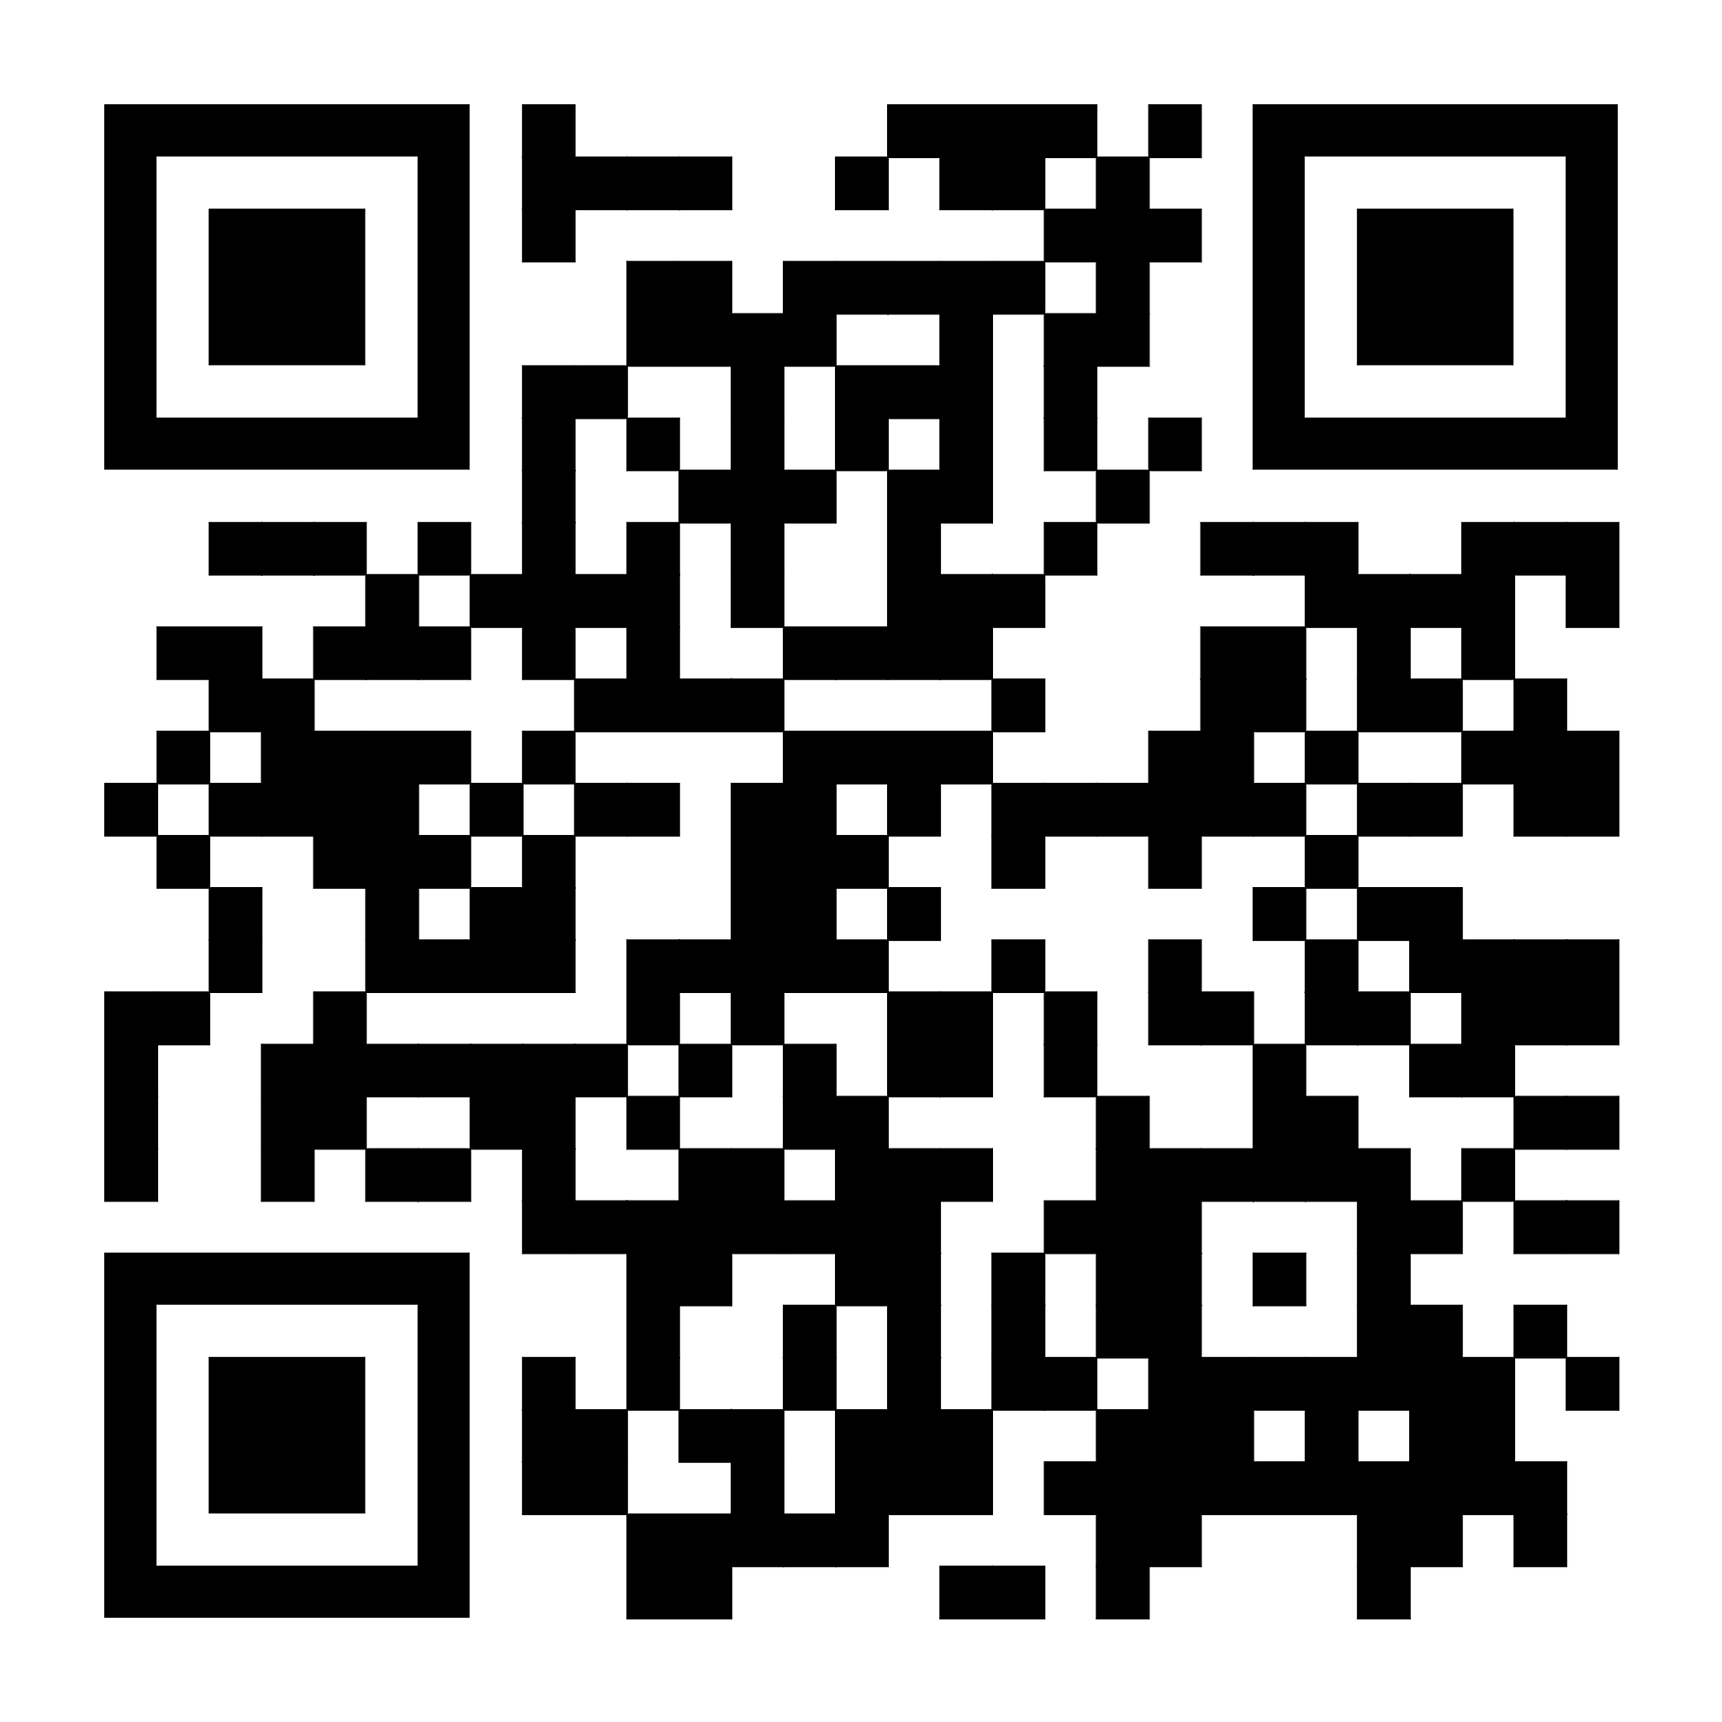
The 12th International Conference on Multiscale Materials Modeling
- Date & Venue : Nov. 9 (Mon) - 13 (Fri), 2026 Sheraton Jeju Hotel, Jeju, Korea
- Important Date
Abstract Submission : Jan. 15 - May 15, 2026
Early-bird Registration : Apr. 15 - Aug. 15, 2026
- Website : mmm12.org
- Sponsored by The Korean Institute of Metals and Materials (KIM)
The International Society for Multiscale Modeling (ISMM)
Website

Slide 2
mmm12.org
Sponsored by
The Korean Institute of Metals and Material (KIM)
The International Society for Multiscale Modeling (ISMM)

